Slide 1






CASE STUDY
Data Collection and Analysis: Automobile Practice
Client Challenge
Our Solution
Outcome
To aid analysis for projects in the automobile sector, the client needed to collect data from an e-commerce platform and analyse this data.
The firm was looking for an efficient :
Infomineo’ s Data Analytics delivered:
A full-fledged webscraping tool, operable through a user interface was delivered to the client.
The solution enabled the client to extract listings from the e-commerce platform, across all cities and categories, using specific keywords.
This data and the insights generated will then be used by the client when developing strategy propositions for corporate clients served by its automobile practice.
An end-to-end solution using Python, wrapped in a Graphical User Interface (GUI) to improve user experience. In addition, the solution was delivered as a Pypi package
An efficient and effective way to regularly collect data from an e-commerce website which operates in Morocco
Using the data collected, generate relevant insights that are relevant to one of the client’s practice areas

Slide 2
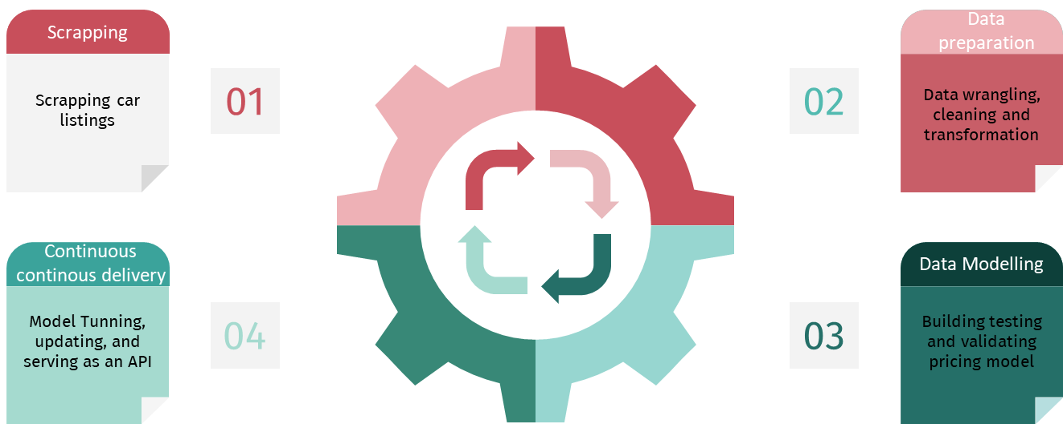
Car pricing – scrapping to model delivery
Achievements
Designing a global scrapping tool on a major listing hub by working around technological barriers thanks to our dynamically correcting headers method.
Create a pipeline of data preparation for an ML pricing model. Data is scrapped, wrangled cleaned and transformed. We identified sold items by detecting missing listings from one day to the other.
Models are trained at each end of pipeline and the best models and parameters are selected to be leveraged by our API

Slide 3


Time Series Analysis: Real Estate
CASE STUDY
Client Challenge
Our Solution
Outcome
Thanks to the web app, in a few clicks, a price can be computed for any real estate asset, for forecasting or pricing, on any platform.
Client:
The client was looking for a tool which would allow them carry out an in-depth analysis of its portfolio assets, estimate real estate prices in their operating markets and assist in planning for potential investments.
The firm was looking for :
The company decided to use Infomineo’s Data Analytics service as a solution to cover:
A real estate investment company
Machine Learning algorithms
Using state delivered transactions as well as exogenous data
Before the project, senior executives in the company including the CEO relied on price estimates provided by an analyst which involved comparing prices across similar communities.
This approach was time-consuming, oftentimes inaccurate, and offered no trend analysis or provided forecasts
Informative and quick solution
Dashboard creation fast and high quality dashboarding
Fast computing and easy access
With a web app including dashboards
Ad-hoc deliverables :
Web App
in depth understanding of current market and on a particular asset
The firm recognized that the quality of the Data Analytics service provided a consistently useful tool and Infomineo also delivered a case study on a set of assets and provided real time updating of the solution.

Slide 4
Time Series Analysis: Real Estate
xxx
Presentation
Asia
Europe
US
Africa
Middle East
Request
The project’s objective was to deliver a forecasting method of Dubai real estate market and compare “The Sustainable City” to its direct competitors.
Main challenges
Performing a relevant clustering and analysis of Dubai’s real estate projects, with 1M rows over 15 years.
Identifying time related trends in the market.
Estimate the price of any real estate asset located in Dubai with a precision emphasis.
Dubai doesn’t provide any detailed socio-demographic data; therefore, external features are only USD index, Dubai stock market index, oil&gaz index and AED Index.
Infomineo’s approach
Data cleaning, Data Vizualisation, feature engineering.
Using K-means clustering with elbow approach to determine the cluster where The Sustainable City is.
Perform statistical analysis of time series predictions for the TSC and its direct competitors.
Compute and fine tune time series algorithms : NPTS, Simple feed forward, ARIMA, SARIMAX, seasonal trends, Transformer …
Predict the price of any asset through Machine learning algorithms : tree based, neuronal networks, regressions …
Deliverable
A web-app for data visualization, mapping and price-prediction tools
A presentation to introduce the application and detail our work and our assumptions

Slide 5
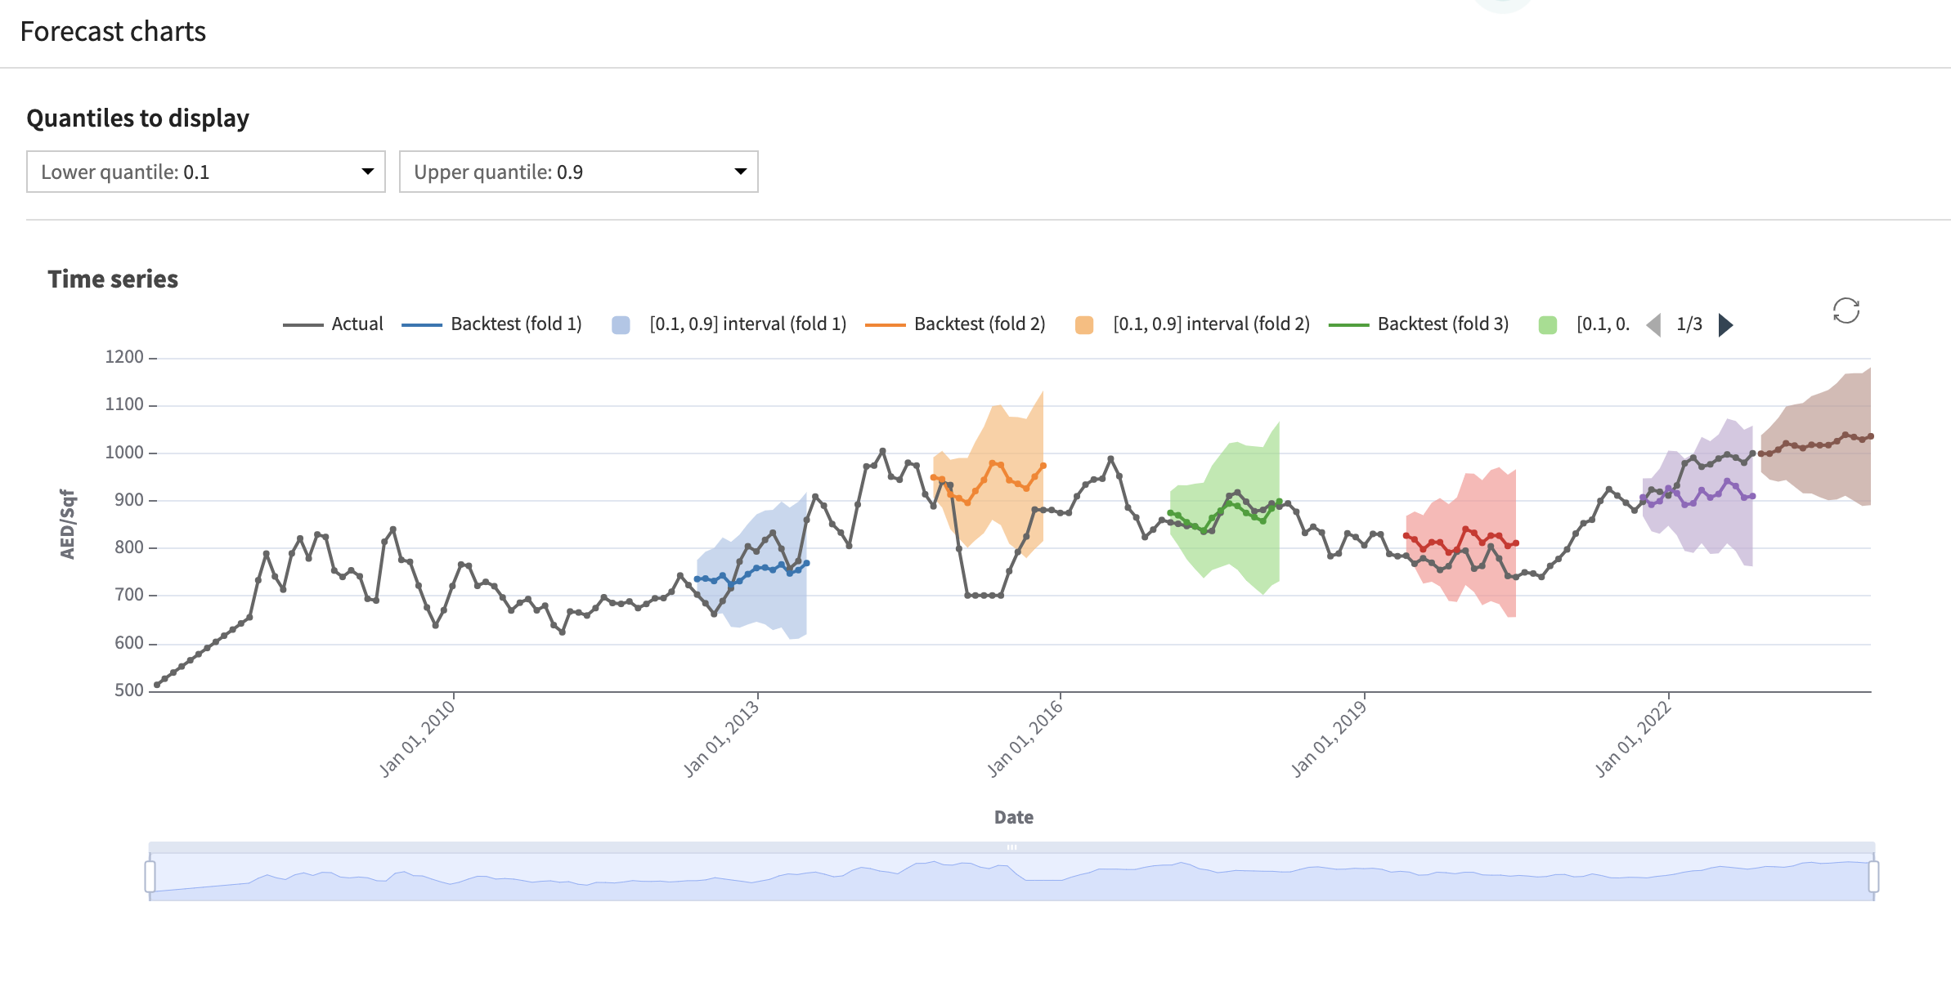
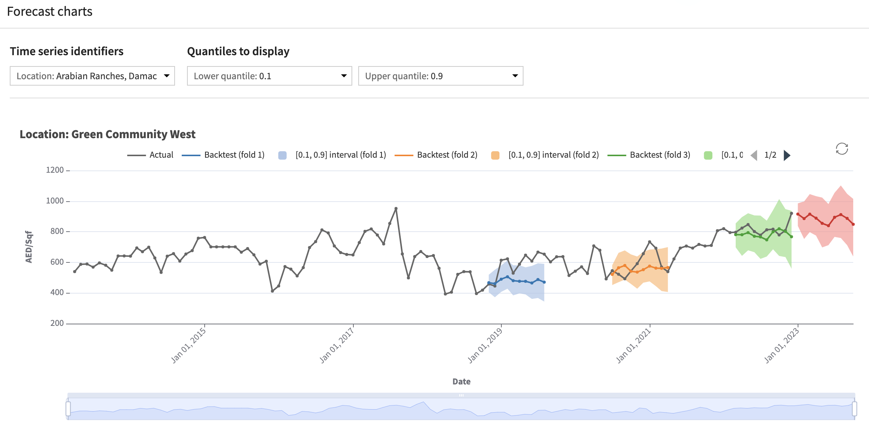
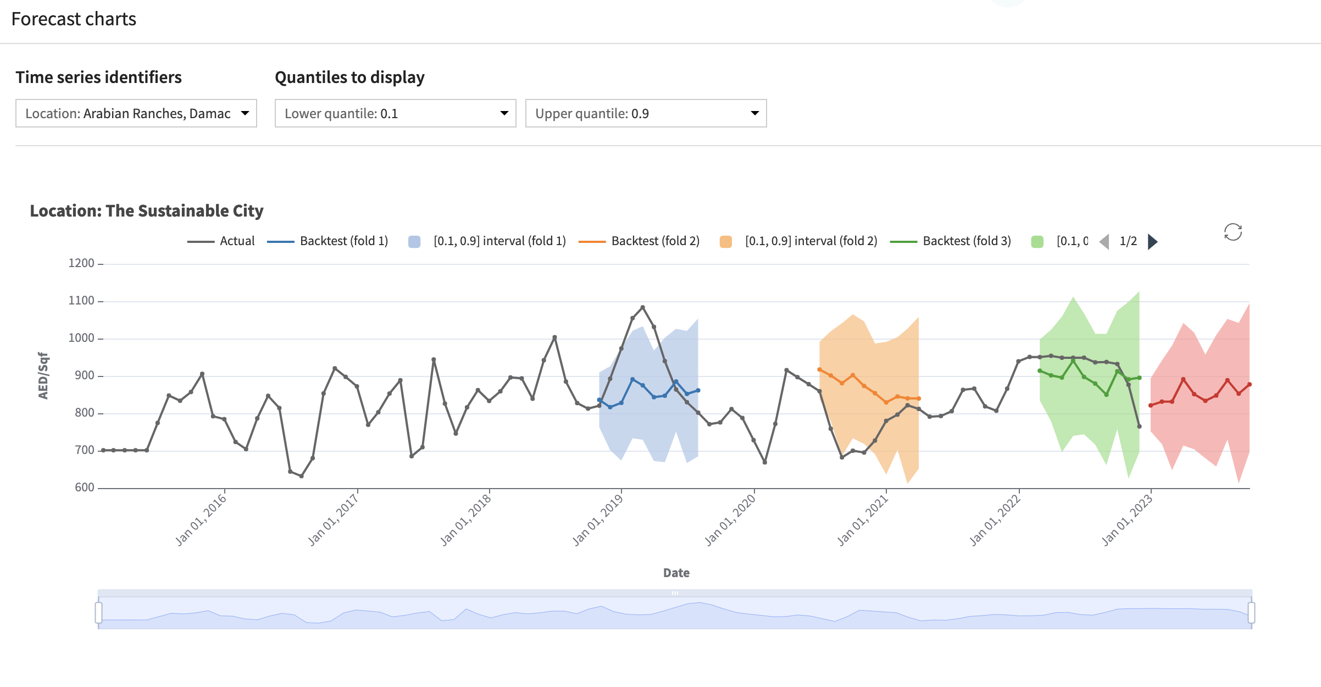
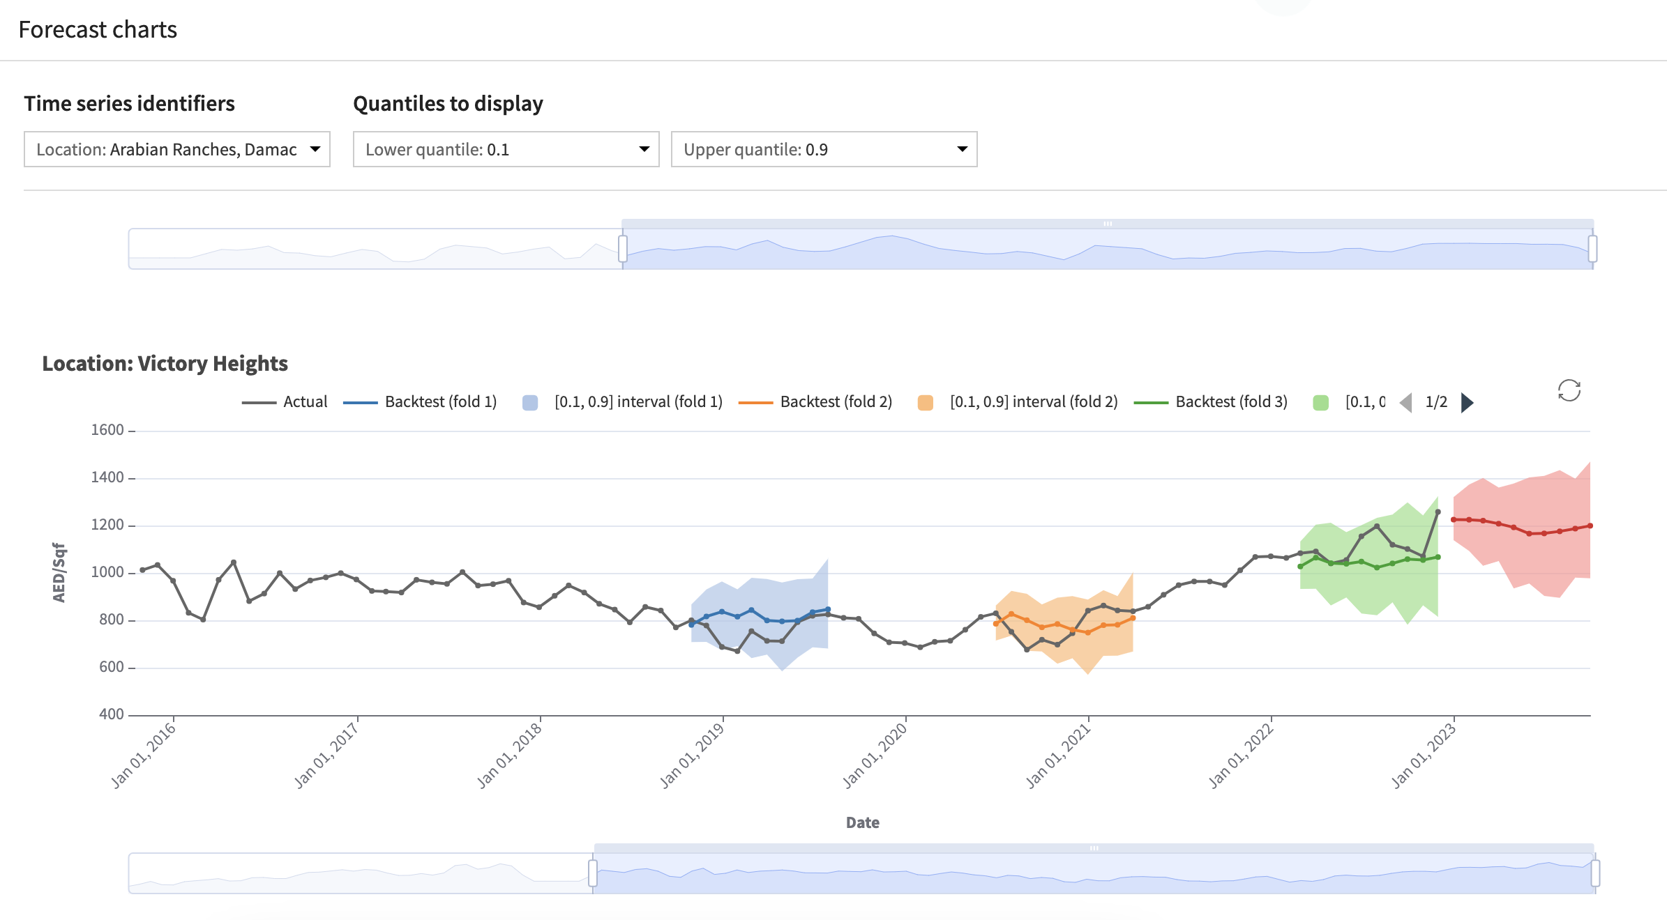
TIME SERIES ANALYSIS
Our data consist of all real estate transactions in Dubai for the last 15 years. We also added economic data such as the dollar index to track inflation, oil&gaz index, stock index …
Dubai real estate is separated in 3 main categories : apartments, villas and townhouses. Those are, most of the time, located in communities that are built and sold following phases. After clustering the data with K-means, The Sustainable City appeared to be a medium luxury community, with a target of foreign and young customers. TSC has mainly townhouses and villas, with a green and sustainable identity. 8 other communities are within the cluster and are similar and close to TSC.
We then analyzed our data by statistical tests, in particular : Durbin-Watson for autocorrelation, Kwiatkowski for non-stationarity, Zivot-Andrews for trend stationarity and Mann-Kendall for trend. Conclusions were that the only community of the cluster that follows an autocorrelated time series, non-flat, and having a highly increasing trend was The Sustainable City. The best performing time series model was neural networks scoring a 6% MAPE, a highly accurate forecasting according to literature. Below are displayed time series forecastings for the whole Dubai real estate market and for TSC as well as two comparative competitors.
Dubai all market
Green Community West
The Sustainable City
Victory Heights

Slide 6
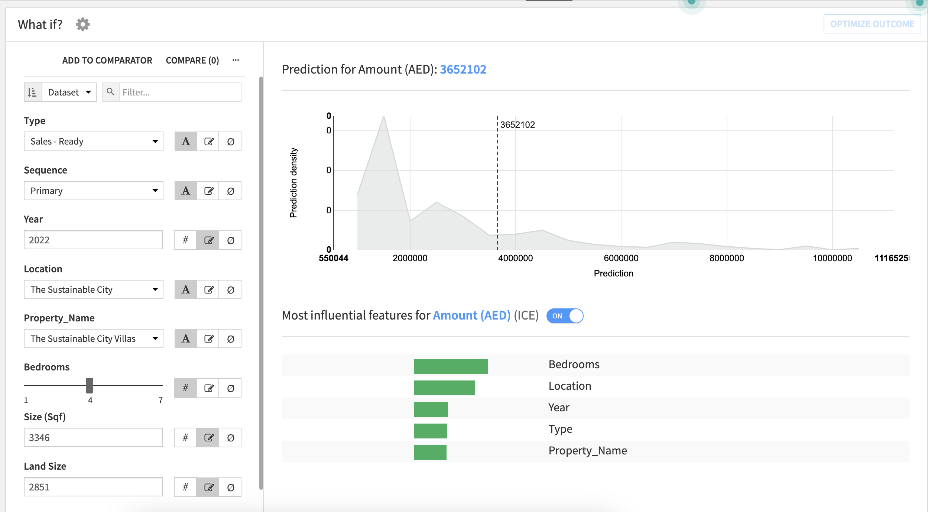




Price Estimation App
The web-app built in feature, allows the user to quicky evaluate the value of his assets. We are constantly keeping data up to date by pulling new transactions from official sources every month. We also avoid data drifting by automatically recomputing models and tunning hyperparameters.
Modelling
Web app
After data cleaning, feature visualization, and preprocessing, the fields we used to build our model were:
Type : sale type of the transaction ex : Ready, off-plan …
Sequence : if the transactions involves primary or secondary phasis of a project
Year : year of transaction
Location : a hundred of different location neighborhoods and communities around Dubai
Property_Name : more granular than Location, it gives the particular bloc
Bedrooms : number of bedrooms
Size (Sqf) : built size in square feet
Land Size : Land size in square feet
Optimization and fine tunning of our tree-based models gave an R2 score of 0.92 and a MAPE of 13%. Those results are highly positive and informative and constitute a satisfying POC.
Next Steps → In the following steps, we will feed our model with more exogenous and geospatial data, in order to reduce the Mean Average Percentage Error. Data like demographics, nearby places (shops, public utility, leisure etc..) geolocation, Stock index, Oid&gas index…. Will all be added to make the model even more accurate.

